Slide 1
School of Geography and Earth Sciences McMaster University
Applied Spatial Statistics
Area Data
I & II

Slide 2
This session:
Area Data
  Definitions
  Visualization
  Spatial proximity matrices

Slide 3
The difference between spatially continuous data and area data
Time series
Temperature
Interest Rates
Temperature
Interest rates
Time
Time

Slide 4
Scale of Analysis

Slide 5
Area Data
Examples of data in the social sciences
  Urban population density
    What is the distribution of population in a city?
    Links to locational theory
  Residential insurance coverage
    Do insurance companies redline neighborhoods?

Slide 6
Area Data
Examples of data in the social sciences
  Urban crime
    Does criminal behavior follow spatial patterns?
    Are there spillover effects?
  Geographic distribution of minorities
    Is there spatial segregation of minorities?

Slide 7
Area Data
Examples of data in the social sciences
  Voter turnout
    What explains voter turnout in elections?

Slide 8
Area Data
Area data in the environmental sciences
  Agricultural experiments in regularly tilled fields
  Species habitat
  Intersection between social and environmental sciences
    NOx spillovers in Europe

Slide 9
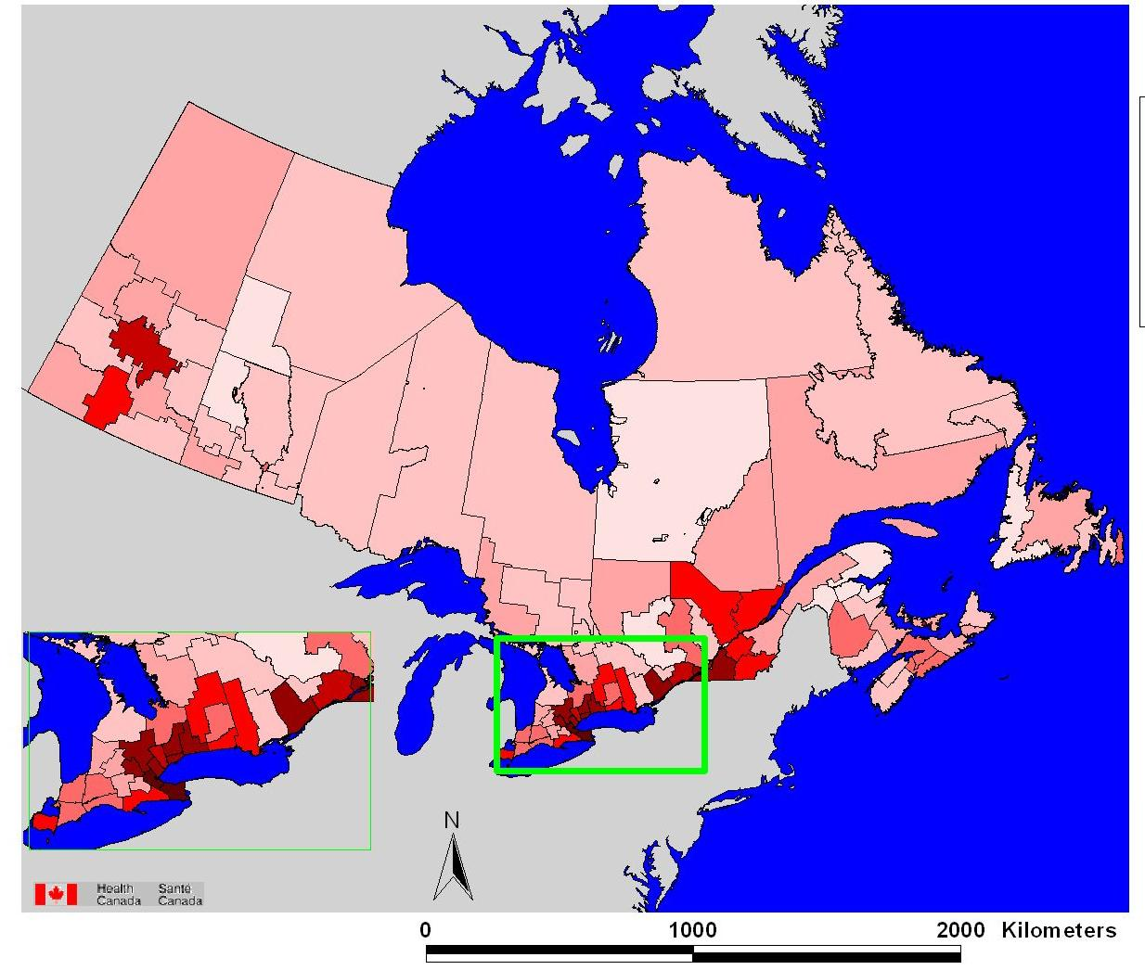
Health Issues:
Number of dead birds reported (2000)

Slide 10
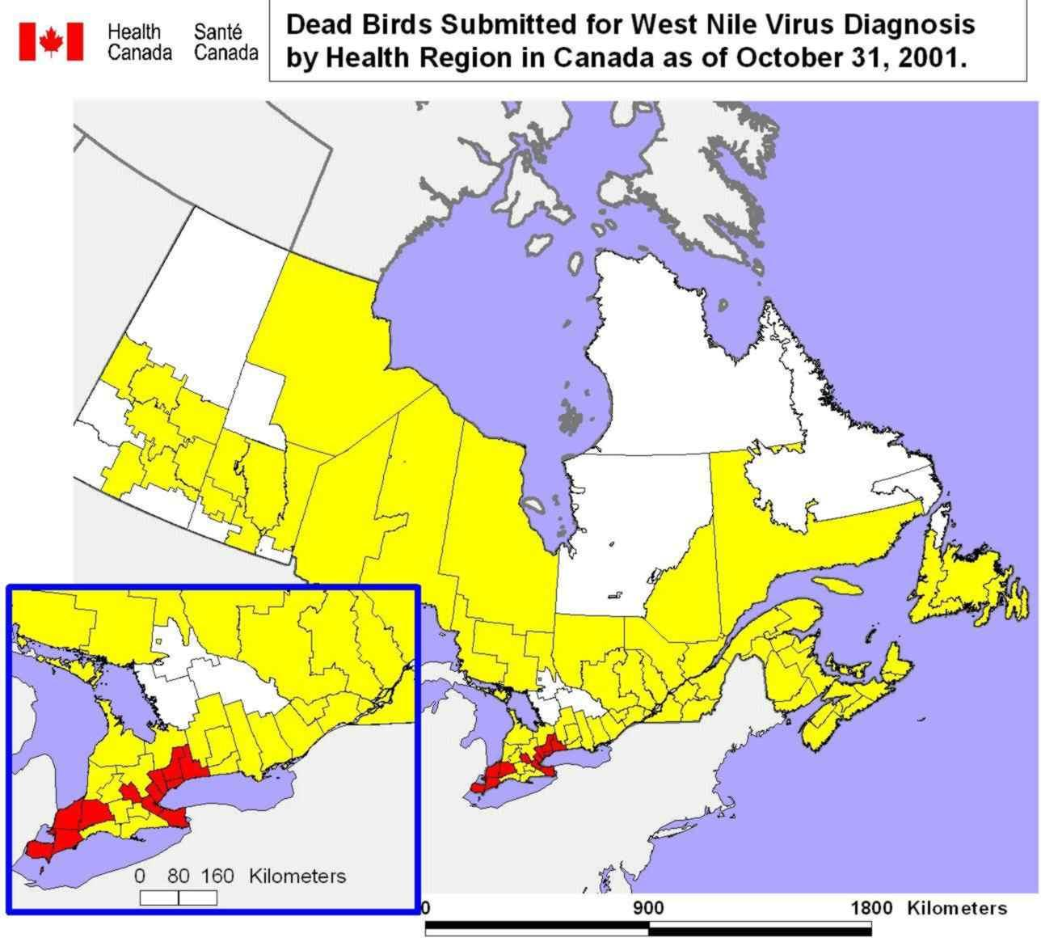
Health Issues:
Dead birds reports

Slide 11
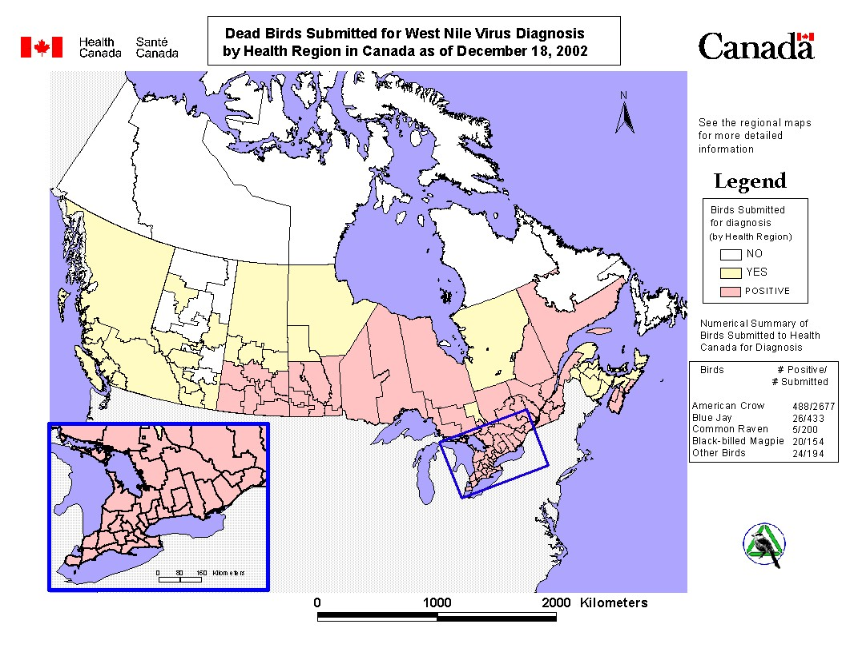
Health Issues:
Dead birds reports

Slide 12
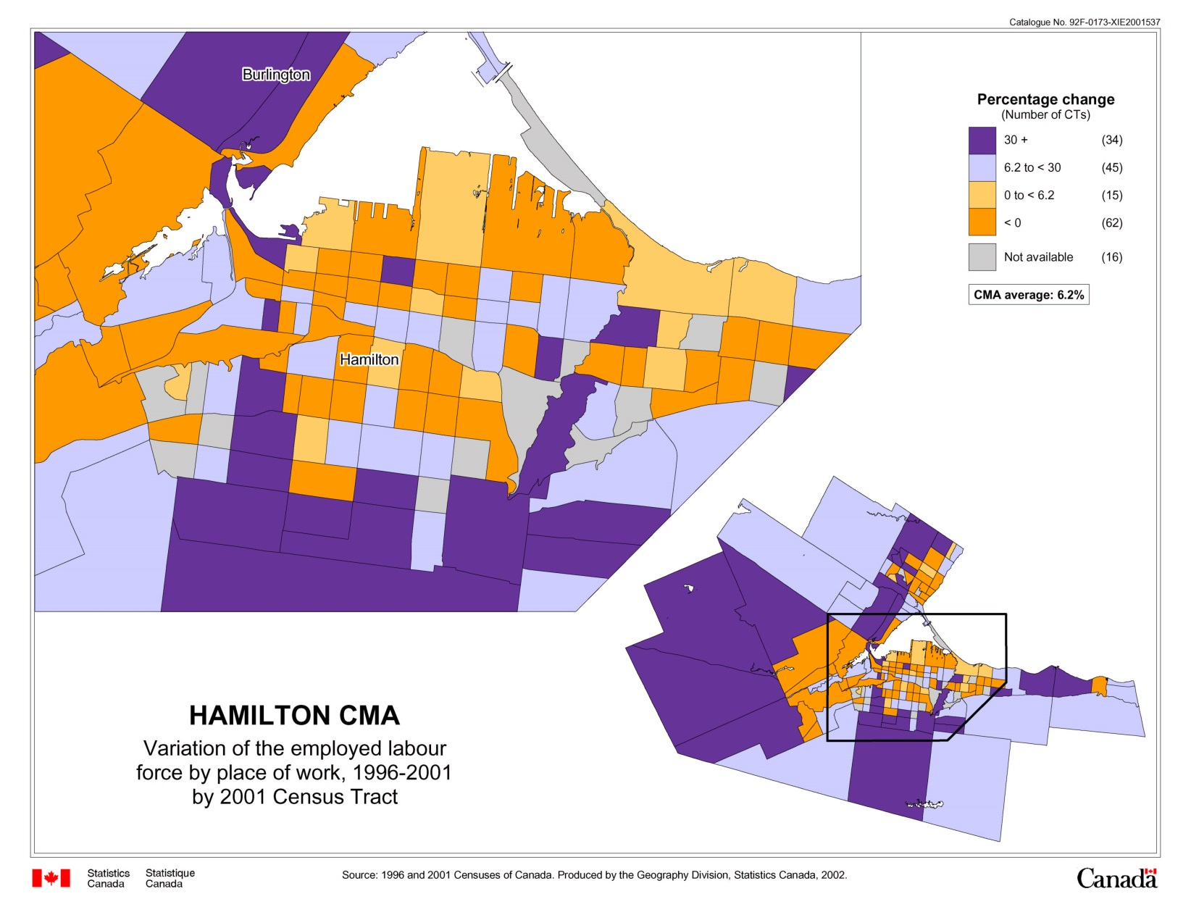
Socio-economic Issues:
Employment

Slide 13
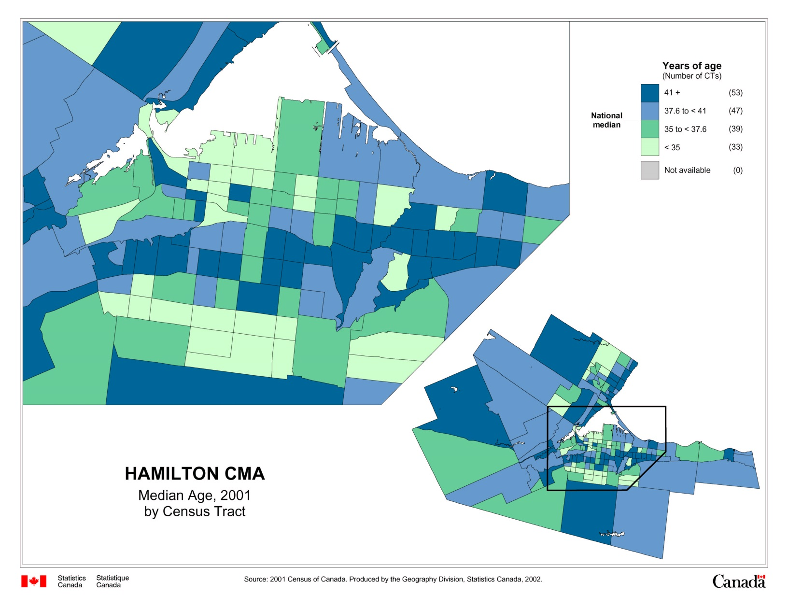
Demographic Issues:
Aging

Slide 14
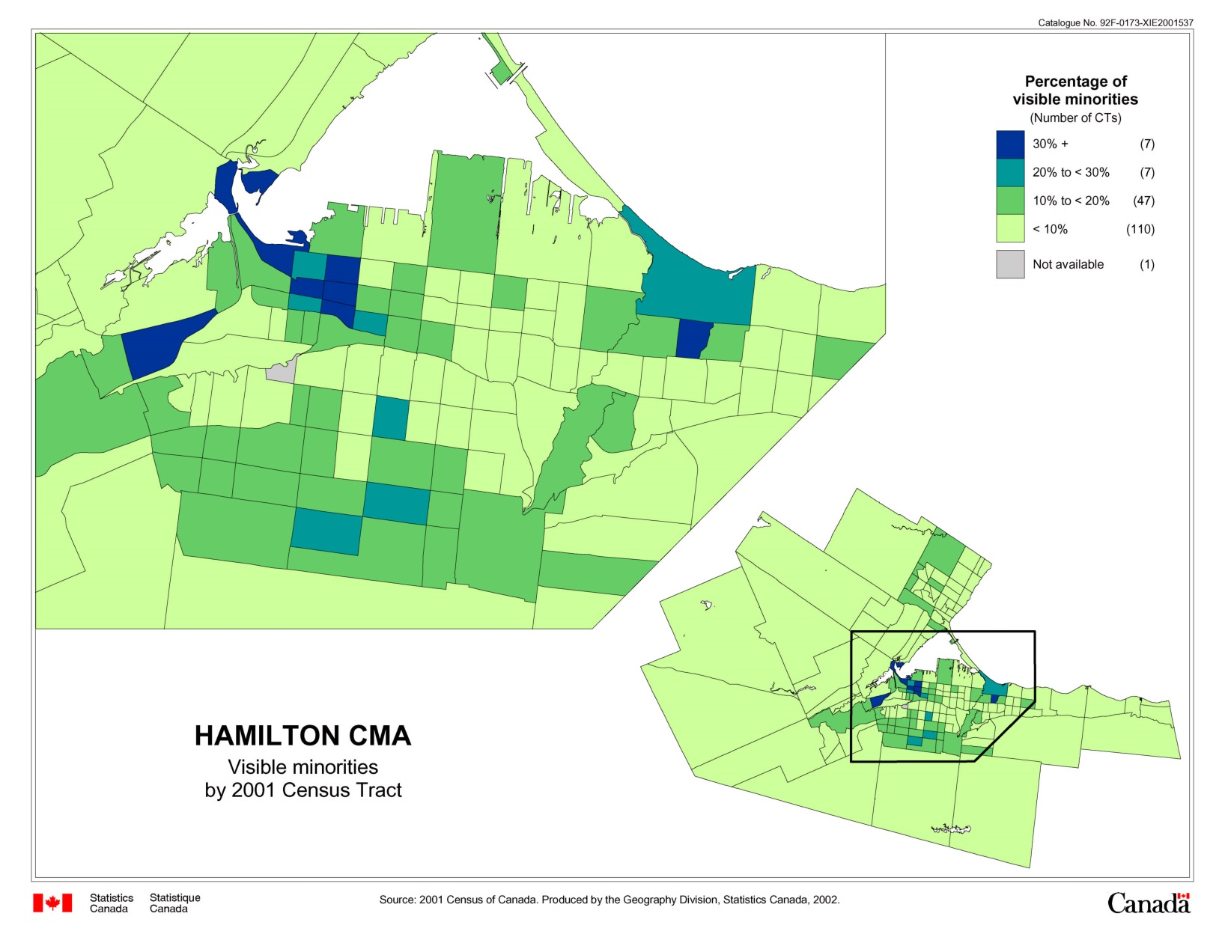
Demographic Issues:
Ethnicity

Slide 15
Goals of Applications: Area data
The description of important features
Estimation of an average value over large areas
The estimation of an average value over small areas
Explanation of patterns and trends
(first order and second order effects)

Slide 16
Analysis of Area Data
Main objective is to explain and possibly to forecast
Analysis follows the usual sequence:
  Visualization and exploration
  Modeling
  First order and second order effects

Slide 17
Definitions
Region
Regular lattice
Irregular lattice
Zones (Areas)
Attributes
First order effects
Second order effects

Slide 18
Definitions: Region
Region (R) – Specific area over the surface of the earth that is of interest

Slide 19
Definitions: Regular Lattice

Slide 20
Definitions: Regular Lattice

Slide 21
Definitions: Regular Lattice

Slide 22
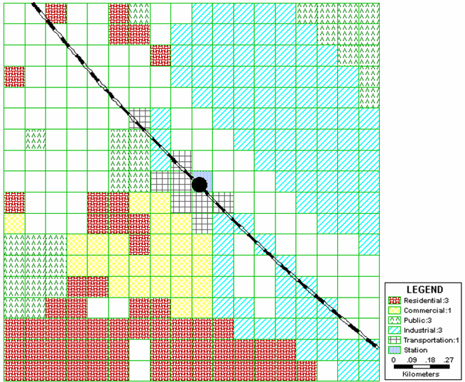
Definitions: Regular Lattice
Example: Land use change

Slide 23
Definitions: Irregular Lattice

Slide 24









Definitions: Zones (Areas)

Slide 25
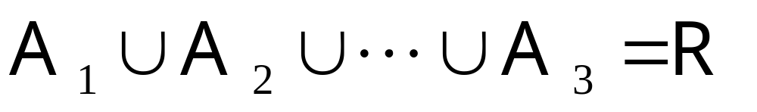
Definitions: Zones (Areas)

Slide 26
Definitions: Zones (Areas)

Slide 27
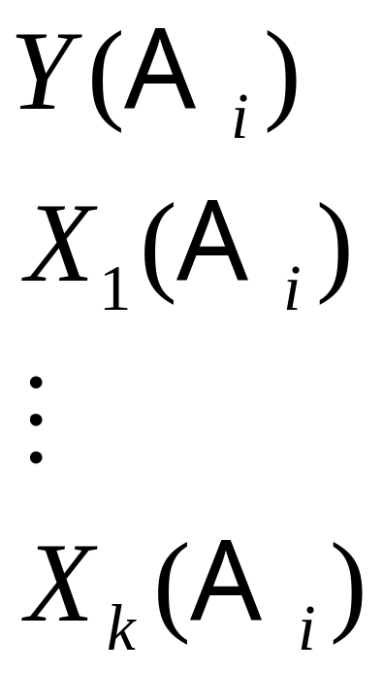
Definitions: Attributes (Area Data)

Slide 28
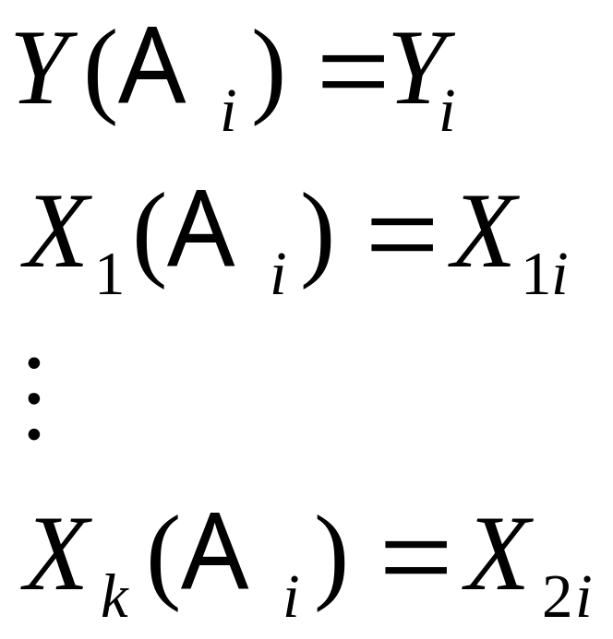
Definitions: Attributes (Area Data)

Slide 29
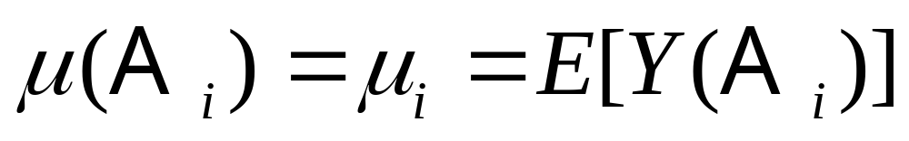
First Order Effects
Expected value of Y for area A
(systematic, deterministic)

Slide 30
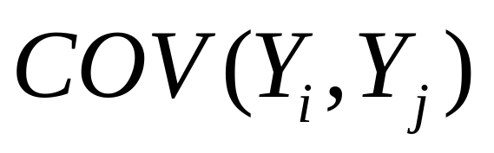
Second Order Effects
Covariance between of Y(A_{i}) and Y(A_{j})
(systematic, deterministic? random, unpredictable?)

Slide 31
Visualization of Area Data
Proportional symbols
Choropleth maps
Density equalized maps

Slide 32
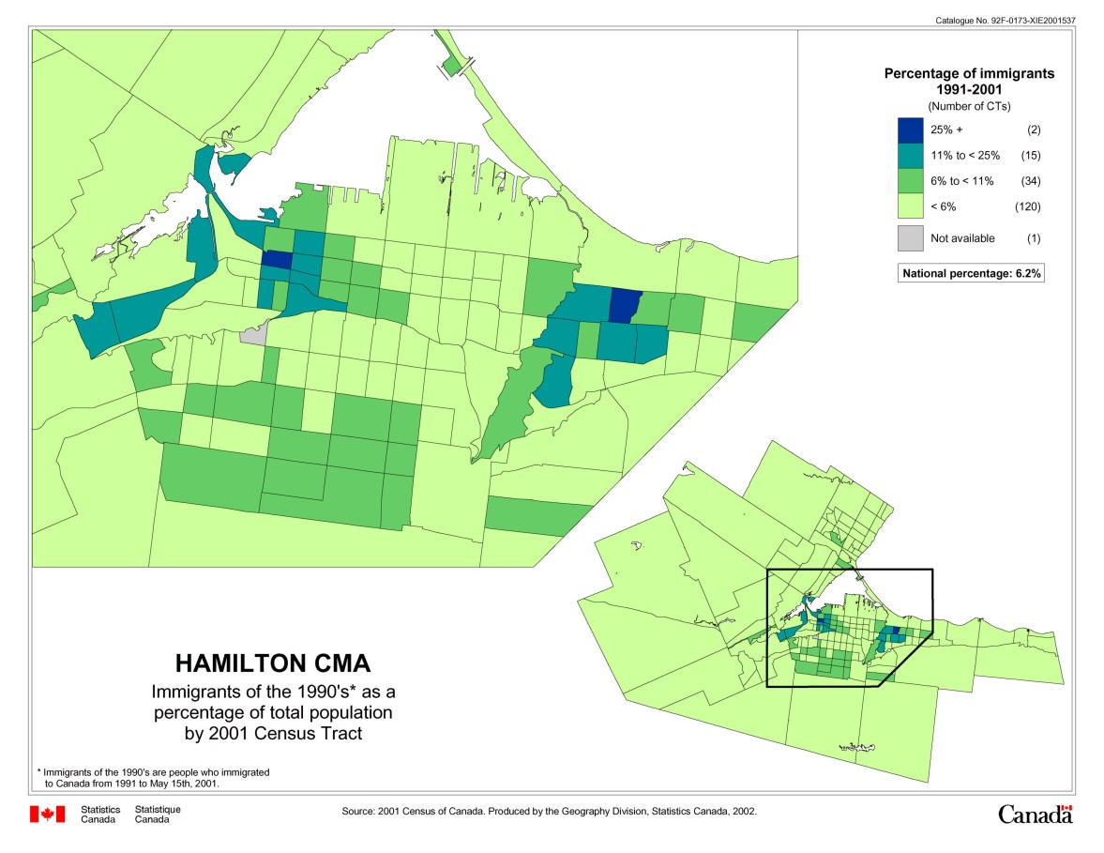
Visualization: Choropleth Maps
Area colors depend on the value of the attribute

Slide 33
Visualization: Choropleth Maps
Some issues
  Selection of class intervals
  Large areas – small areas
  Interpretability

Slide 34
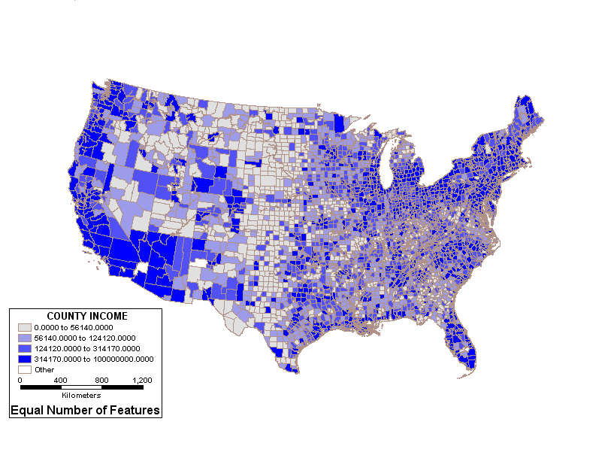
Choropleth Maps:
Selection of Class Intervals

Slide 35
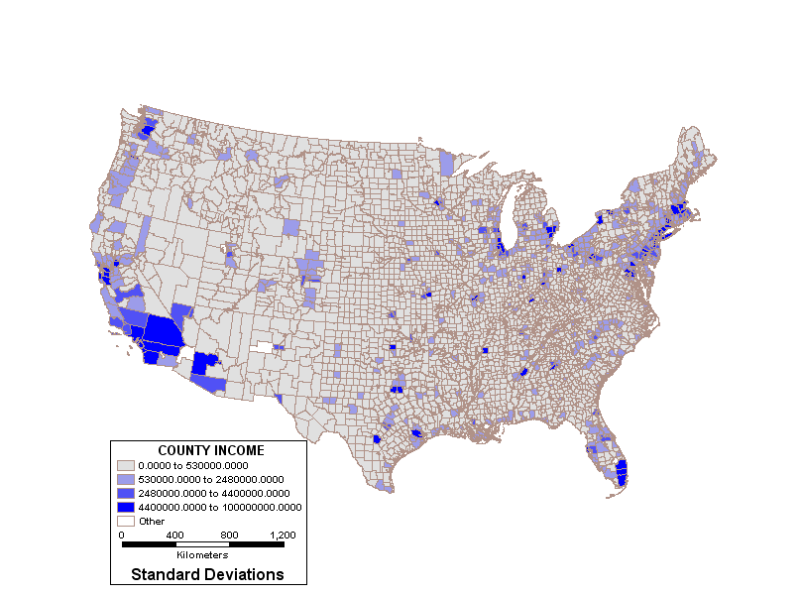
Choropleth Maps:
Selection of Class Intervals

Slide 36
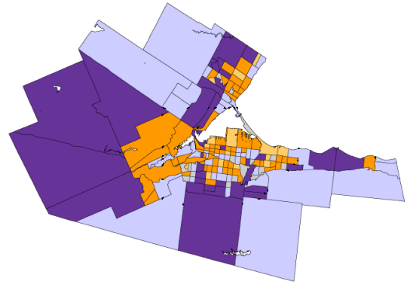
Choropleth Maps:
Large Zones – Small Zones
Notes:
Large areas dominate the display

Slide 37
Choropleth Maps:
Interpretability
Number of classes
Positive – negative attribute values

Slide 38

Choropleth Maps:
Interpretability
Number of classes

Slide 39
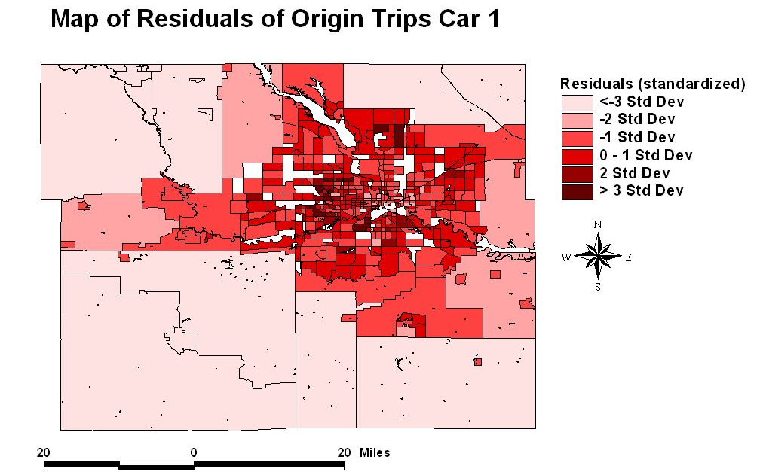
Choropleth Maps:
Interpretability
Positive – Negative attribute values

Slide 40
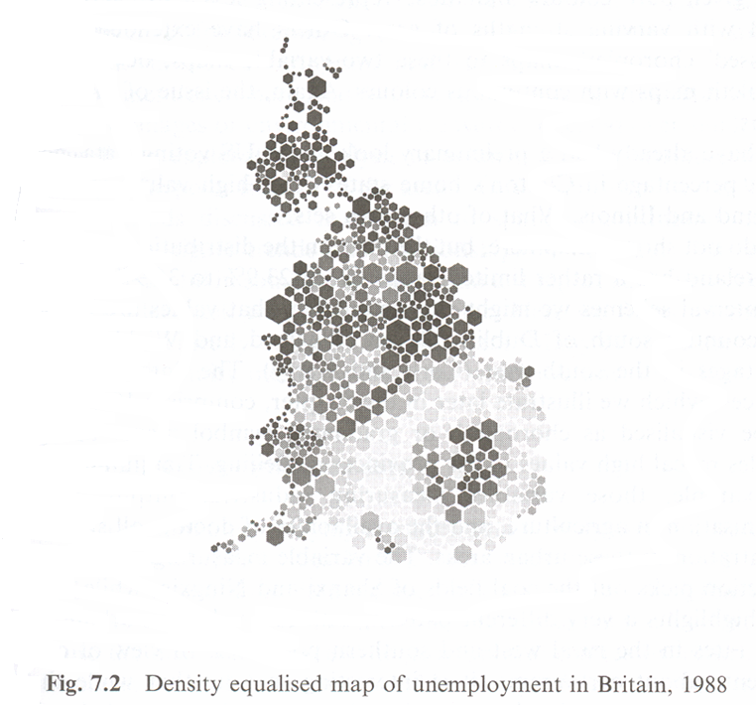
Visualization:
Density Equalized Maps
Example

Slide 41
Exploration of Area Data
Spatial Moving Averages
Kernel Estimation

Slide 42
Spatial Proximity
How is proximity defined for area data?
Spatial proximity matrix W

Slide 43
Spatial Proximity Matrix
Contiguity
A₁
A₂
A₃
A₄

Slide 44
Spatial Proximity Matrix
A₁
A₂
A₃
A₄
0
 | 0
 |  | 0
 |  |  | 0
A₁
A₂
A₃
A₄

Slide 45
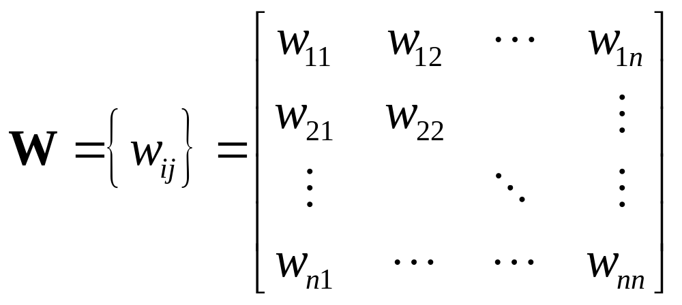
Spatial Proximity Matrix

Slide 46
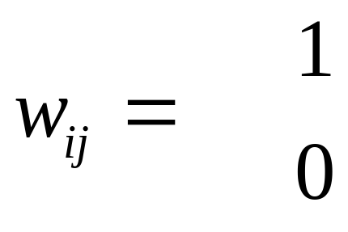
Spatial Proximity Matrix
Definition of weights w_{ij}
if A_{j} shares a border with A_{i}
otherwise

Slide 47
Spatial Proximity Matrix
Contiguity
A₁
A₂
A₃
A₄

Slide 48
Spatial Proximity Matrix
A₁
A₂
A₃
A₄
0
 | 0
 |  | 0
 |  |  | 0
A₁
A₂
A₃
A₄

Slide 49
Spatial Proximity Matrix
Topology?
A₂
A₁
A₃
A₄

Slide 50
Spatial Proximity Matrix
Topology?
A₁
A₂
A₃
A₄

Slide 51
Spatial Proximity Matrix
Topology?
A₁
A₂
A₃
A₄

Slide 52
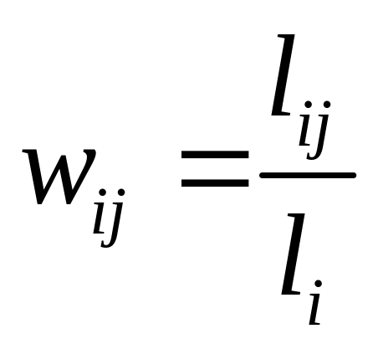
Spatial Proximity Matrix
Alternative definition of w_{ij}
  Length of shared boundary
  l_{ij}:length of common boundary between A_{j} and A_{j}
  l_{i}:perimeter of A_{j}

Slide 53
Spatial Proximity Matrix
Zone centroids: transforming area data into point data
A₂
A₁
A₃
A₄

Slide 54
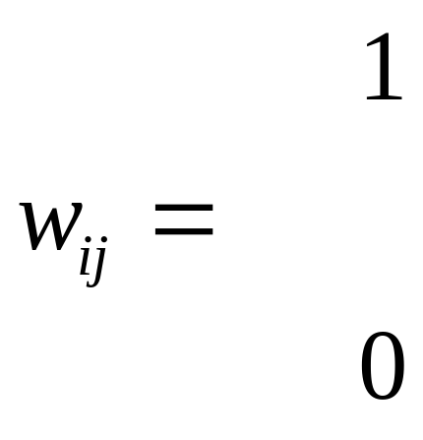
Spatial Proximity Matrix
Alternative definition of w_{ij}
if centroid of A_{j} is one of
k nearest neighbors to that of A_{i}
otherwise

Slide 55
Spatial Proximity Matrix
Alternative definition of w_{ij}
if centroid of A_{j} is within specified
distance to that of A_{i}
otherwise

Slide 56
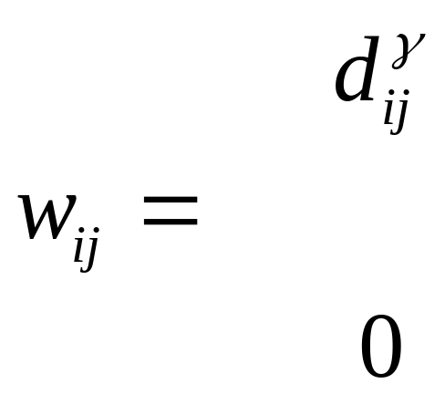
Spatial Proximity Matrix
Alternative definition of w_{ij}
if inter-centroid distance d_{ij} < δ
(δ >0; γ<0)
otherwise

Slide 57
Spatial Proximity Matrix
Higher order matrices W
  First order “neighbors”
  Second order “neighbors”

Slide 58
Spatial Proximity Matrix
Higher order matrices
A₁
A₂
A₃
A₄

Slide 59
Spatial Proximity Matrix
A₁
A₂
A₃
A₄
0 | 0 | 1 | 0
0 | 0 | 0 | 1
1 | 0 | 0 | 0
0 | 1 | 0 | 0
A₁
A₂
A₃
A₄

Slide 60
Spatial Proximity Matrix
Row-standardization of W
A₁
A₂
A₃
A₄

Slide 61
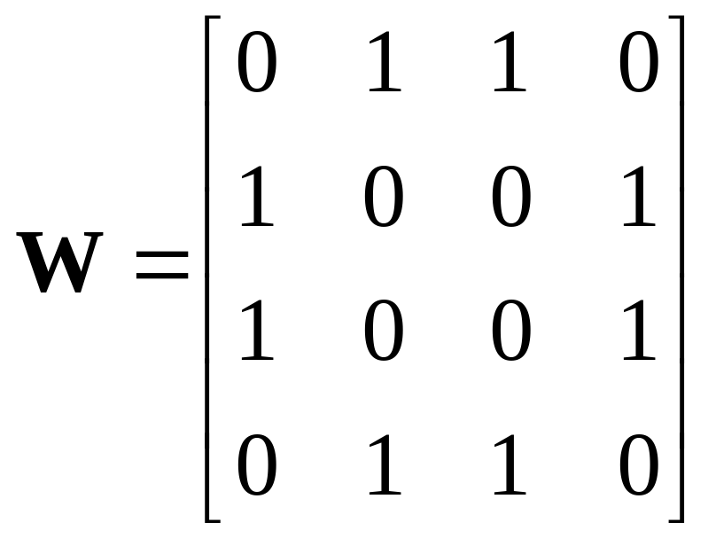
Spatial Proximity Matrix
Row-standardization of W

Slide 62
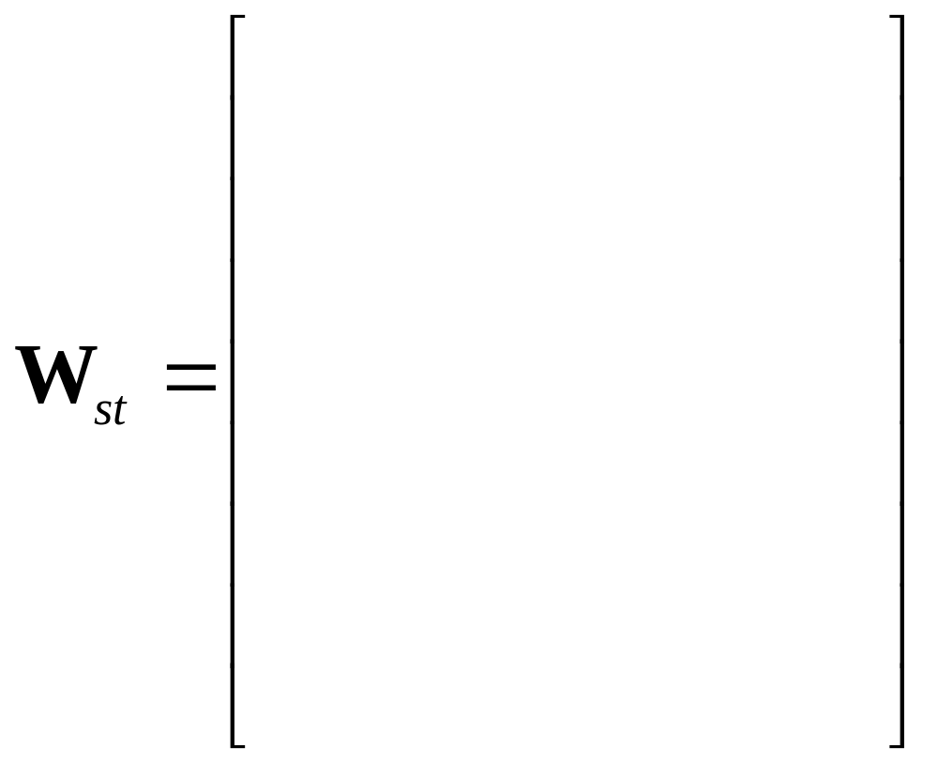
Spatial Proximity Matrix
Row-standardization of W

Slide 63
Spatial Proximity Matrix
Network data
  The units of analysis are nodes in a network
  For example, cities in a transportation network
  Network connectivity gives the proximity matrix

Slide 64
Next…
Exploring area data
First order effects
Second order effects

